Slide 1
Chapter Nineteen
Monopoly Behavior
垄断行为

Slide 2
How Should a Monopoly Price?
So far a monopoly has been thought of as a firm which has to sell its product at the same price to every customer. This is uniform pricing.
Can price-discrimination （差别定价）earn a monopoly higher profits?

Slide 3
Structure
First-degree price discrimination
Second-degree price discrimination
Third-degree price discrimination
Bundling
Two-part tariff

Slide 4
Types of Price Discrimination
1st-degree: Each output unit is sold at a different price. Prices may differ across buyers.
2nd-degree: The price paid by a buyer can vary with the quantity demanded by the buyer. But all customers face the same price schedule. E.g. bulk-buying discounts.

Slide 5
Types of Price Discrimination
3rd-degree: Price paid by buyers in a given group is the same for all units purchased. But price may differ across buyer groups.
E.g., senior citizen and student discounts vs. no discounts for middle-aged persons.

Slide 6
First-degree Price Discrimination
Each output unit is sold at a different price. Price may differ across buyers.
It requires that the monopolist can discover the buyer with the highest valuation of its product, the buyer with the next highest valuation, and so on.

Slide 7



First-degree Price Discrimination
$/output unit
Sell the th unit for $
MC(y)
p(y)
y

Slide 8




First-degree Price Discrimination
$/output unit
Sell the th unit for $ Later on
sell the th unit for $
MC(y)
p(y)
y

Slide 9




First-degree Price Discrimination
$/output unit
Sell the th unit for $ Later on
sell the th unit for $ Finally
sell the th unit for marginal
cost, $
MC(y)
p(y)
y

Slide 10
First-degree Price Discrimination
The gains to the monopolist
on these trades are:
and zero.
$/output unit
MC(y)
p(y)
y
The consumers’ gains are zero.

Slide 11
First-degree Price Discrimination
So the sum of the gains to
the monopolist on all
trades is the maximum
possible total gains-to-trade.
$/output unit
PS
MC(y)
p(y)
y

Slide 12
First-degree Price Discrimination
The monopolist gets
the maximum possible
gains from trade.
$/output unit
PS
MC(y)
p(y)
y
First-degree price discrimination
is Pareto-efficient.

Slide 13
First-degree Price Discrimination
First-degree price discrimination gives a monopolist all of the possible gains-to-trade, leaves the buyers with zero surplus, and supplies the efficient amount of output.

Slide 14
Examples of 1st-degree Price Discrimination
Auction of antique
May not be practical
  do not know willingness to pay
  too costly

Slide 15
Second-degree Price Discrimination
Non-linear pricing
  Unit price depends on quantity purchased
  Bulk discount
Setting
  A seller does not know the willingness to pay by each individual buyer
  Consumer’s marginal willingness to pay declines with quantity

Slide 16
Second-degree Price Discrimination
Mechanism： Set price for different volumes to let consumers identify themselves

Slide 17
An Example
Two consumers
  Person 1 has low willingness-to-pay
  Person 1 has high willingness-to-pay
Assume 0 MC

Slide 18
Second-degree Price Discrimination
Charge A for x₁⁰ hoping to get person 1
Charge A+B+C for x₂⁰ hoping to get person 2
But person 2 is better off buying x₁⁰ and receiving a cs=B
Fail to let consumers self-select themselves
Profit=2A
Can alternatively charge A+C for x₂⁰
to identify person 2
profit=2A+C
$/output unit
B
A
C
x₁⁰
x₂⁰
quantity

Slide 19
Second-degree Price Discrimination
Reduce x₁⁰ so A is reduced by a little but C can be increased by a lot。Persons 1 and 2 are still identified
Profit is higher
$/output unit
B
A
C
x₁⁰
x₂⁰
quantity

Slide 20
Second-degree Price Discrimination
Profit is maximized at x₁^{m}
$/output unit
B
MC(y)
A
C
x₂⁰
quantity
x₁^{m}

Slide 21
Second-degree Price Discrimination
2nd-degree discrimination can also occur in the dimension of quality
Different prices for different seats in a theater
Different prices for economy class vs. business class seats in airplanes

Slide 22
Third-degree Price Discrimination
Price paid by buyers in a given group is the same for all units purchased. But price may differ across buyer groups.
Quality of goods is the same across groups.
Can identify groups but no further identification within that group.

Slide 23
Third-degree Price Discrimination
A monopolist manipulates market price by altering the quantity of product supplied to that market.
So the question “What discriminatory prices will the monopolist set, one for each group?” is really the question “How many units of product will the monopolist supply to each group?”

Slide 24
Third-degree Price Discrimination
Two markets, 1 and 2.
y₁ is the quantity supplied to market 1. Market 1’s inverse demand function is p₁(y₁).
y₂ is the quantity supplied to market 2. Market 2’s inverse demand function is p₂(y₂).

Slide 25
Third-degree Price Discrimination
For given supply levels y₁ and y₂ the firm’s profit is
What values of y₁ and y₂ maximize profit?

Slide 26
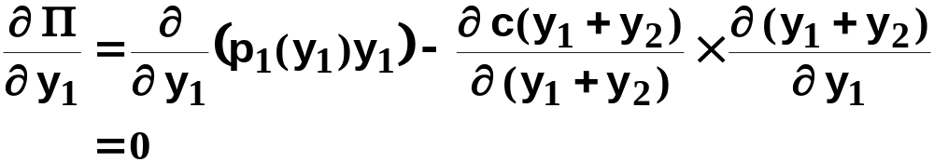
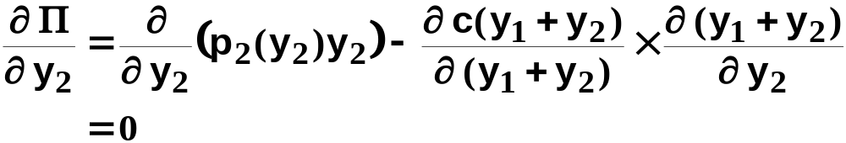
Third-degree Price Discrimination
The profit-maximization conditions are

Slide 27
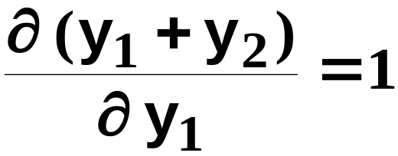
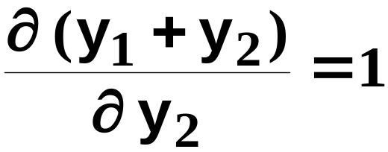
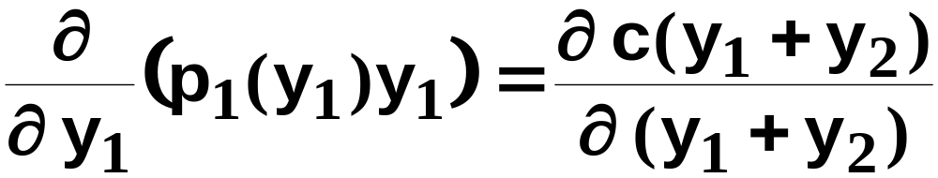
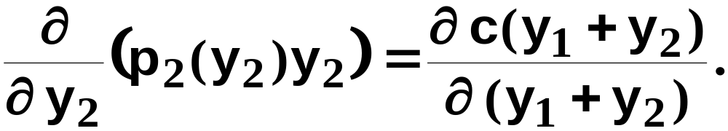
Third-degree Price Discrimination
and
so
the profit-maximization conditions are
and

Slide 28
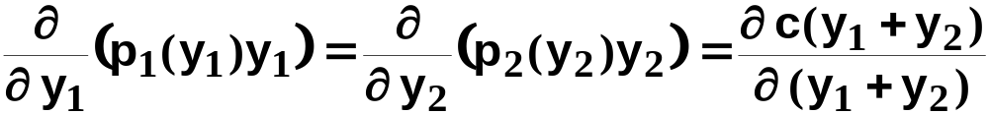
Third-degree Price Discrimination
⎭
⎬
⎫
MR₁(y₁) = MR₂(y₂) says that the allocation
y₁, y₂ maximizes the revenue from selling
y₁ + y₂ output units.
E.g. if MR₁(y₁) > MR₂(y₂) then an output unit
should be moved from market 2 to market 1
to increase total revenue.

Slide 29
Third-degree Price Discrimination
⎭
⎬
⎫
The marginal revenue common to both
markets equals the marginal production
cost if profit is to be maximized.

Slide 30
Third-degree Price Discrimination
Market 1
Market 2
p₁(y₁)
p₂(y₂)
p₁(y₁*)
p₂(y₂*)
MC
MC
y₁*
y₁
y₂*
y₂
MR₁(y₁)
MR₂(y₂)
MR₁(y₁*) = MR₂(y₂*) = MC
and p₁(y₁*) ≠ p₂(y₂*).

Slide 31
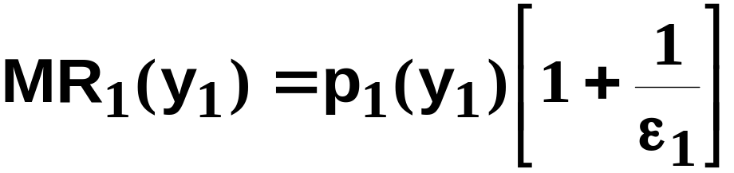
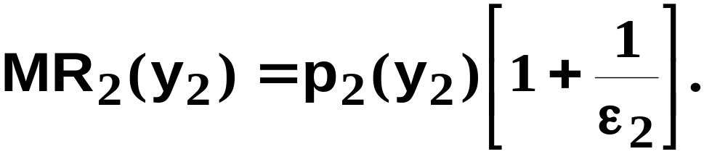
Third-degree Price Discrimination
In which market will the monopolist
set the higher price?
Recall that
and
But,

Slide 32
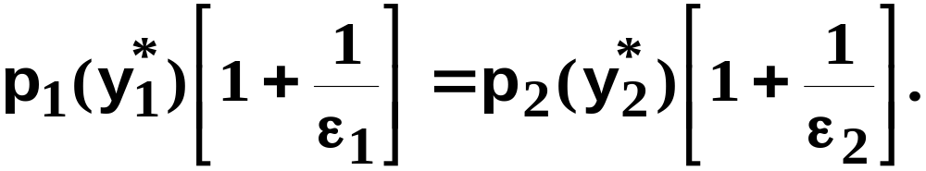
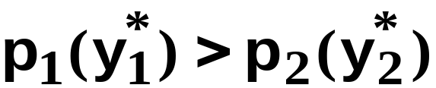
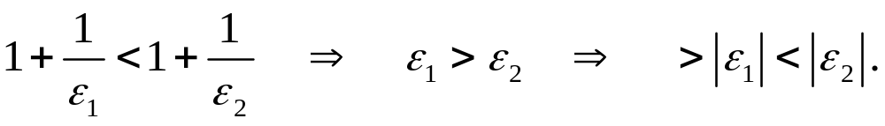
Third-degree Price Discrimination
So
Therefore, only if
The monopolist sets the higher price in
the market where demand is least
own-price elastic.

Slide 33
Examples of 3rd-degree Price Discrimination
Discounts to students, senior citizens
Business travelers and vacationers
Hardcover books and paperback books

Slide 34
Bundling
Willingness to pay for software components
Types of consumers | Word processor | Spreadsheet
Type A | 120 | 100
Type B | 100 | 120

Slide 35
Two Marketing Policies
Sell separately:
  Word processor: p=100, revenue=200
  Speadsheet; p=100, revenue=200
Bundling
  Set p=220 for the bundle
  Revenue=440

Slide 36
Two-Part Tariffs
A two-part tariff is a lump-sum fee, p₁, plus a price p₂ for each unit of product purchased.
Thus the cost of buying x units of product is
p₁ + p₂x.

Slide 37
Two-Part Tariffs
Should a monopolist prefer a two-part tariff to uniform pricing, or to any of the price-discrimination schemes discussed so far?
If so, how should the monopolist design its two-part tariff?

Slide 38
Two-Part Tariffs
p₁ + p₂x
Q: What is the largest that p₁ can be?
A: p₁ is the “entrance fee” so the largest it can be is the surplus the buyer gains from entering the market.
Set p₁ = CS and now ask what should be p₂?

Slide 39

Two-Part Tariffs
$/output unit
Should the monopolist
set p₂ above MC?
p(y)
MC(y)
y

Slide 40
Two-Part Tariffs
$/output unit
Should the monopolist
set p₂ above MC?
p₁ = CS.
p(y)
CS
MC(y)
y

Slide 41
Two-Part Tariffs
$/output unit
Should the monopolist
set p₂ above MC?
p₁ = CS.
PS is profit from sales.
p(y)
CS
MC(y)
PS
y

Slide 42
Two-Part Tariffs
$/output unit
Should the monopolist
set p₂ above MC?
p₁ = CS.
PS is profit from sales.
p(y)
CS
MC(y)
PS
Total profit
y

Slide 43


Two-Part Tariffs
$/output unit
Should the monopolist
set p₂ = MC?
p(y)
MC(y)
y

Slide 44
Two-Part Tariffs
$/output unit
Should the monopolist
set p₂ = MC?
p₁ = CS.
p(y)
CS
MC(y)
y

Slide 45
Two-Part Tariffs
$/output unit
Should the monopolist
set p₂ = MC?
p₁ = CS.
PS is profit from sales.
p(y)
CS
MC(y)
PS
y

Slide 46
Two-Part Tariffs
$/output unit
Should the monopolist
set p₂ = MC?
p₁ = CS.
PS is profit from sales.
p(y)
CS
MC(y)
PS
Total profit
y

Slide 47
Two-Part Tariffs
$/output unit
Should the monopolist
set p₂ = MC?
p₁ = CS.
PS is profit from sales.
p(y)
CS
MC(y)
PS
y

Slide 48
Two-Part Tariffs
$/output unit
Should the monopolist
set p₂ = MC?
p₁ = CS.
PS is profit from sales.
p(y)
CS
MC(y)
PS
y
Additional profit from setting p₂ = MC.

Slide 49
Two-Part Tariffs
The monopolist maximizes its profit when using a two-part tariff by setting its per unit price p₂ at marginal cost and setting its lump-sum fee p₁ equal to Consumers’ Surplus.

Slide 50
Two-Part Tariffs
A profit-maximizing two-part tariff gives an efficient market outcome in which the monopolist obtains as profit the total of all gains-to-trade.

Slide 51
Examples of Two-Part Tariff
Telephone hook-up fee
Membership for a club

Slide 52
Monopolistic Competition (垄断竞争)
Rare to see pure monopoly, other firms may compete by producing similar products.
Implications:
  The monopolist still has market power – demand slopes down
  Competition from similar products drives profit to zero.
  To minimize competition, a firm tries to differentiate product.

Slide 53
Monopolistic Competition
$/output unit
AC(y)
p(y*)
p(y)
y*
y

Slide 54
Monopolistic Competition
$/output unit
MC(y)
AC(y)
p(y*)
p(y)
y*
y
MR(y)

